Slide 1
MovieFreaks
Name: Aparna Chandrasekar
Email: aparna.csa@gmail.com
License: GNU General Public License v3

Slide 2
Description
MovieFreaks is a web application that allows its users to find movies and theatres in and around their locality.
It also allows users to search for their favorite movie, its description and show times.
It allows its registered users to receive SMS alerts whenever a new movie is released in their locality.
The users can also unsubscribe from new movie alerts any time they wish.

Slide 3
Motivation
Existing movie websites provides a facility where the user can save their favorite movie names and they get notified whenever those movies hit the theatres.
Trailers are played only for English movies in theatres.
Not aware of yet to be released other language movies, to be saved in favorites for receiving an alert when they hit the theatres.

Slide 4
Development Tools
Wamp Server 2.5
Apache 2.4.9
MySQL 5.6.17
PHP 5.5.12
HTML
OnConnect Data Delivery API
Clickatell SMS Gateway

Slide 5
Features
List the currently playing movies near the specified zip code.
Look for theatres and the movies being played in each theatre.
Search for a particular movie using a keyword.
Send SMS alert on release of a new movie.

Slide 6
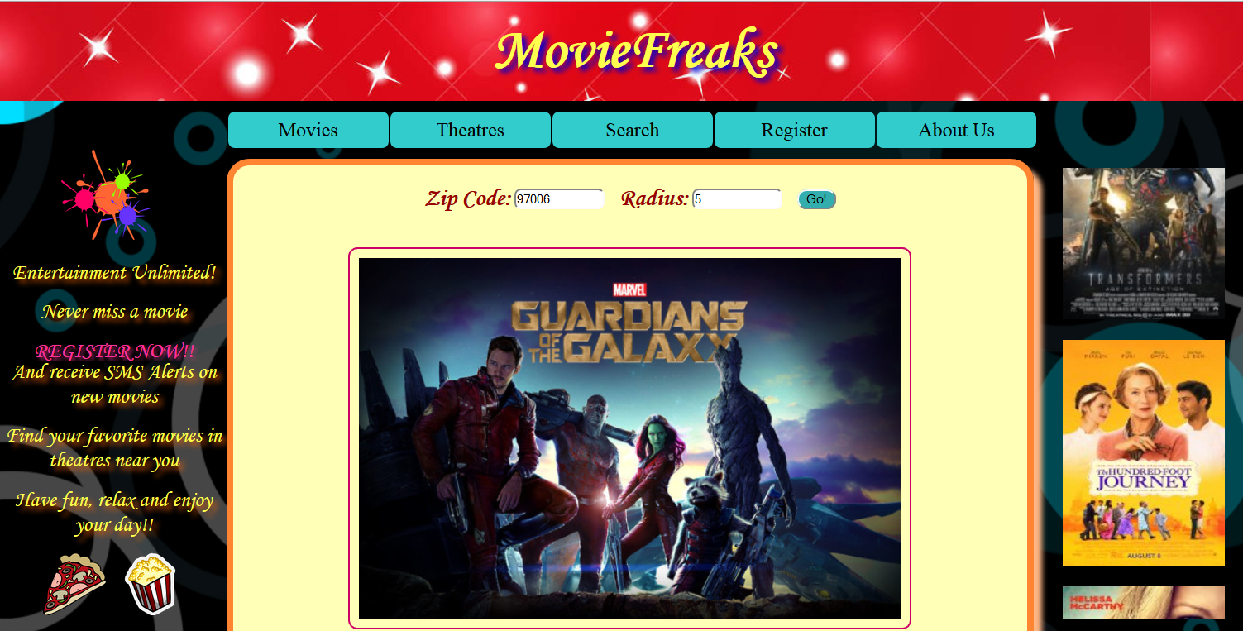

Slide 7
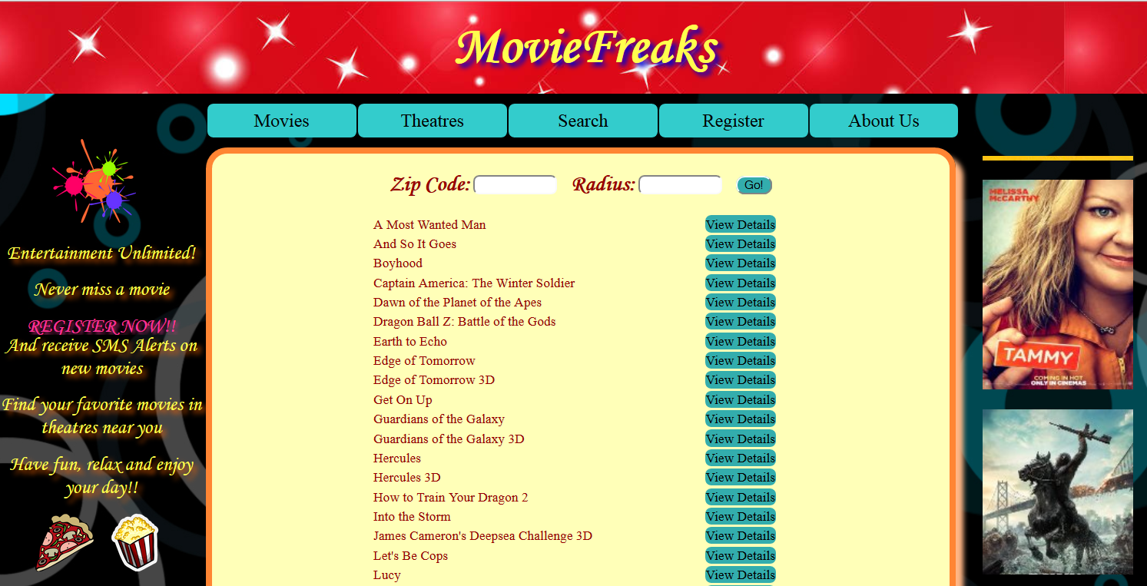

Slide 8
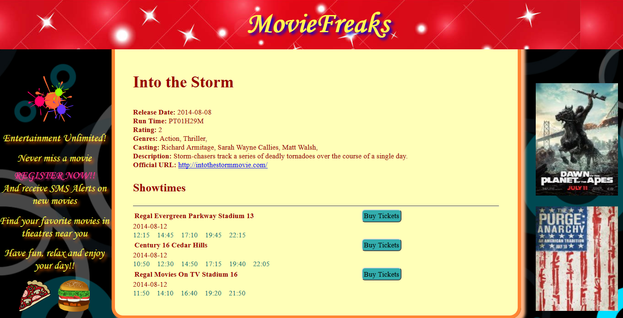

Slide 9
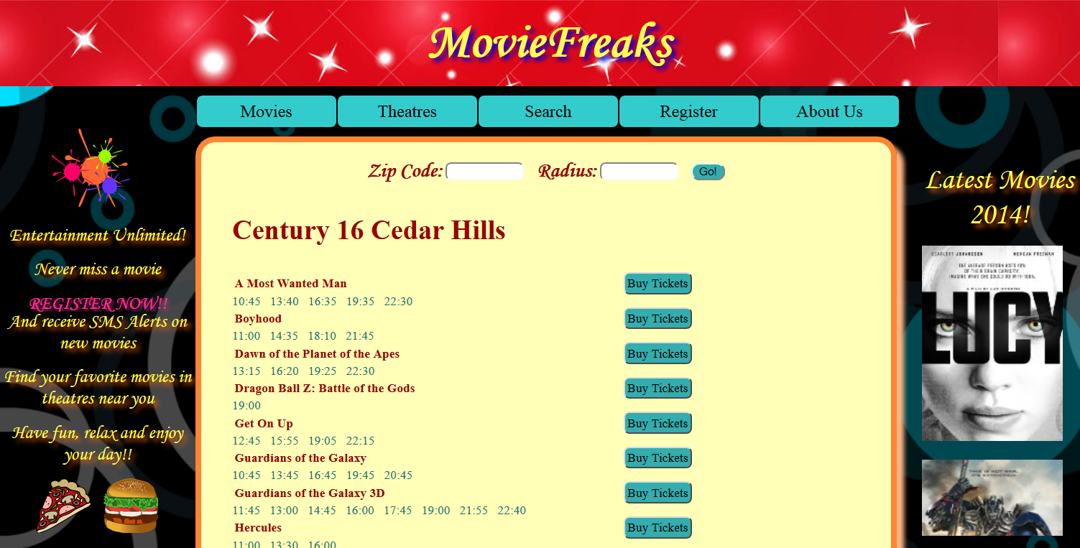

Slide 10
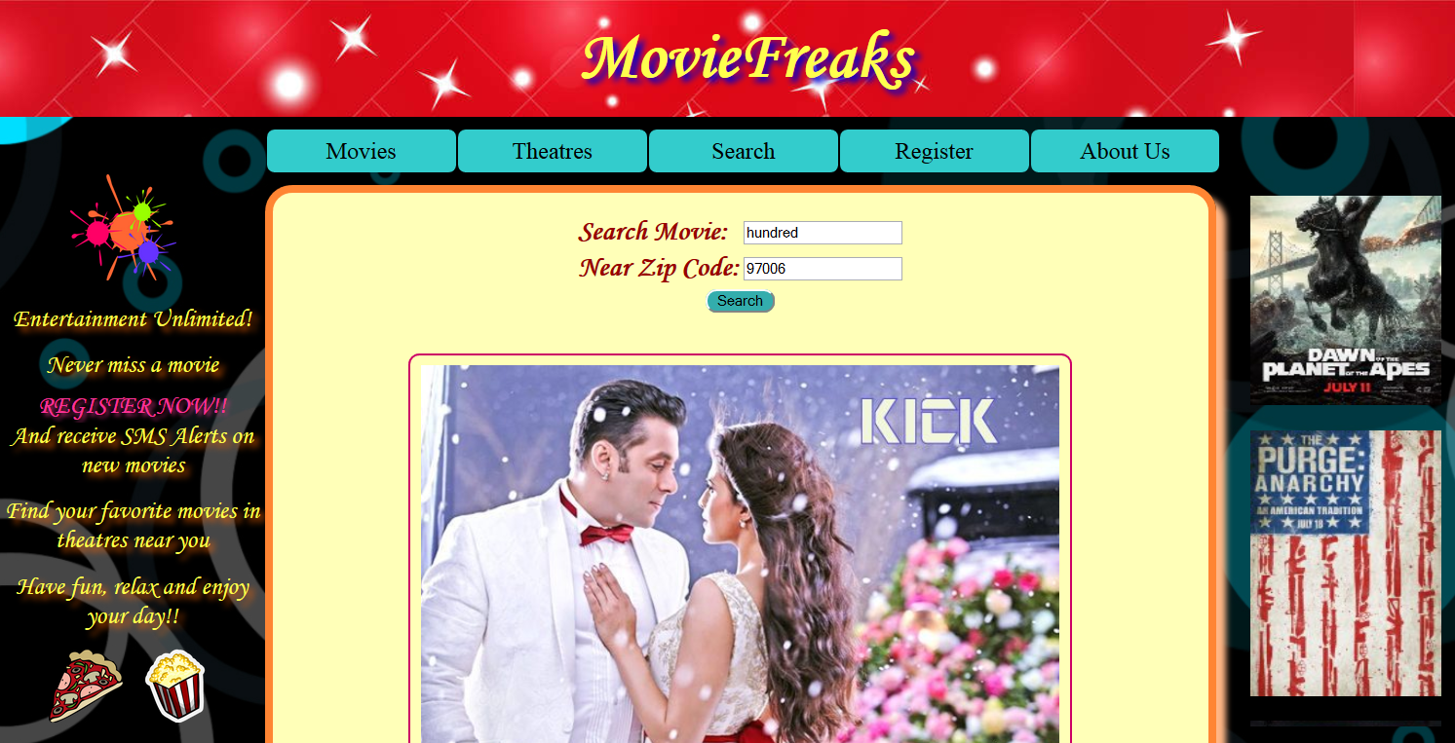

Slide 11
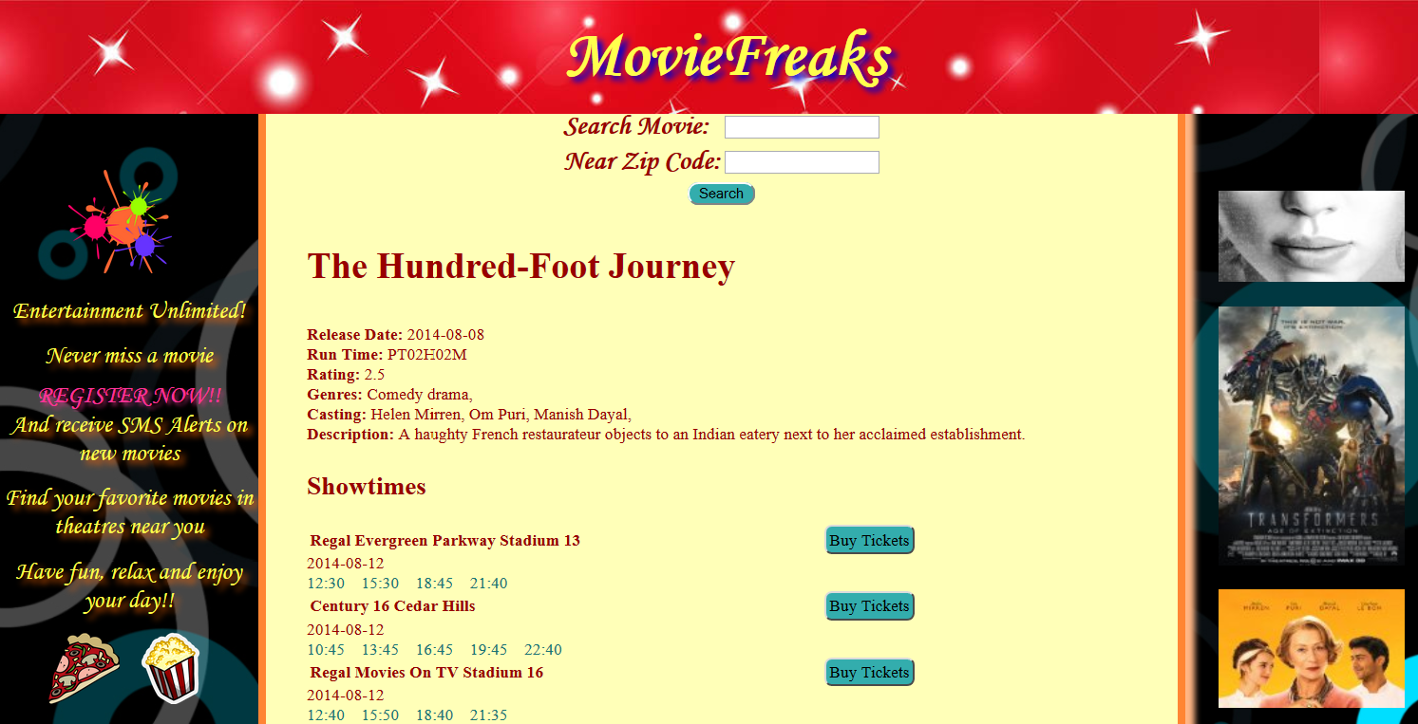

Slide 12
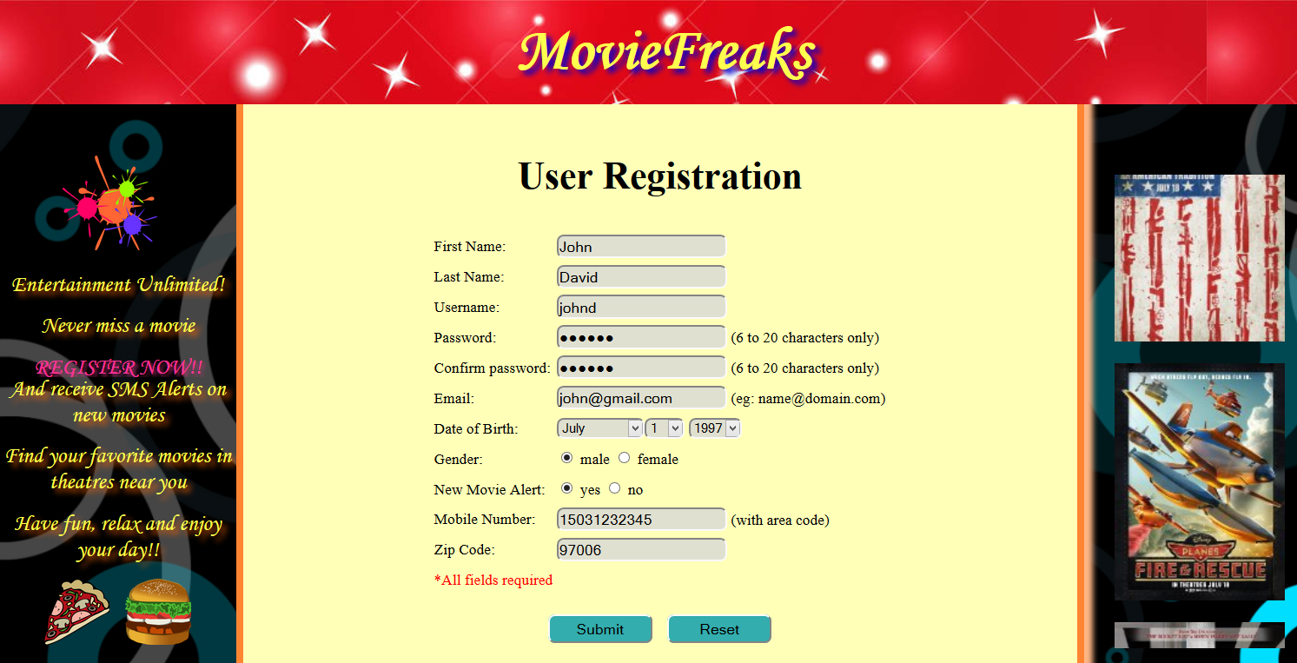

Slide 13
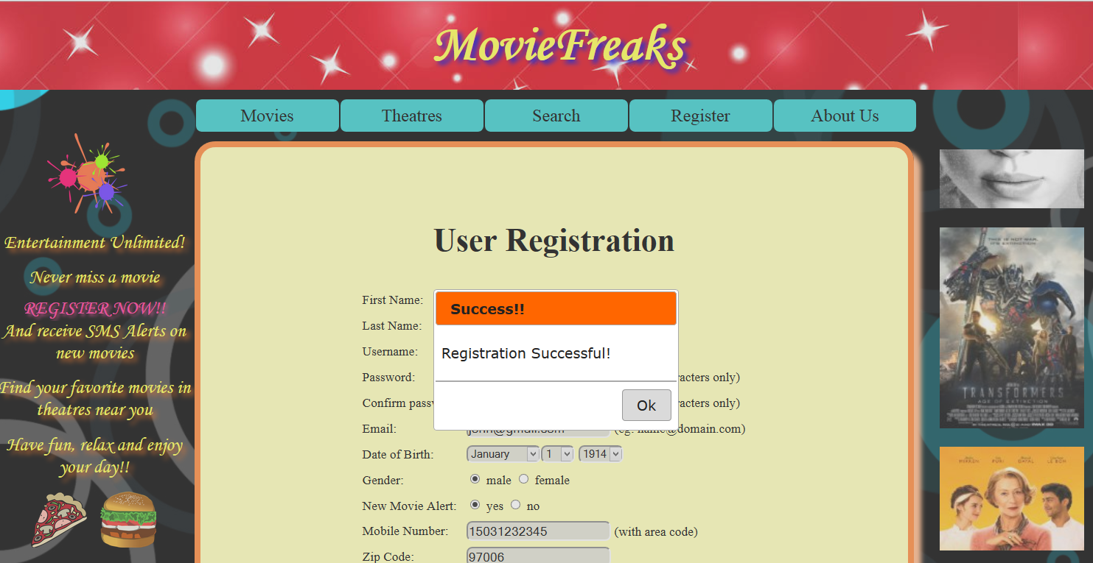

Slide 14
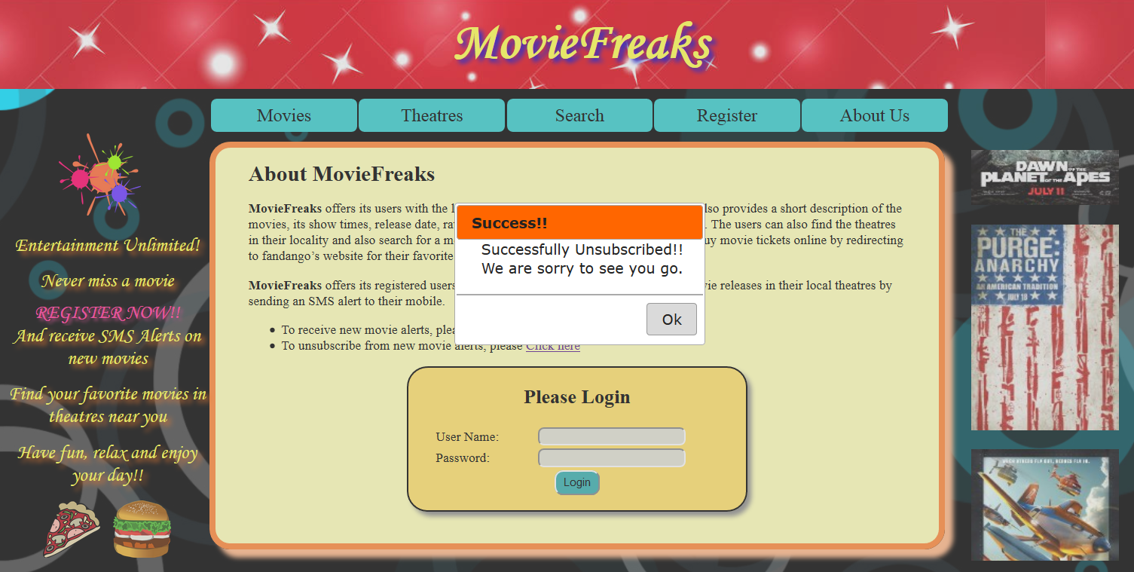

Slide 15
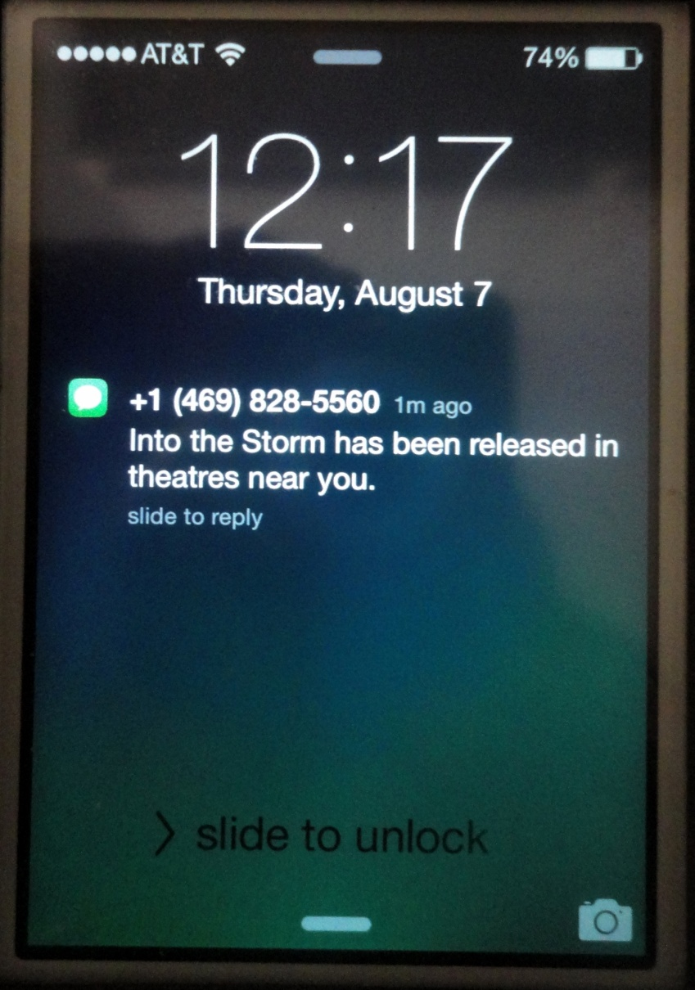
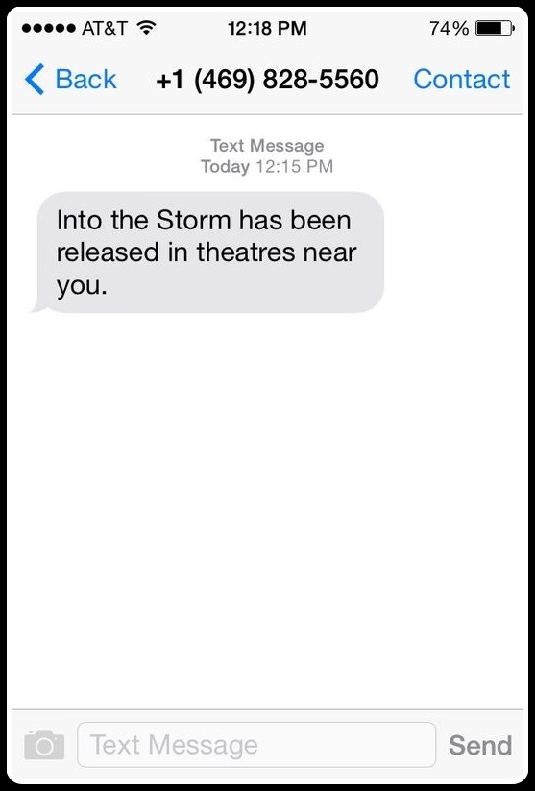

Slide 16
Challenges
Figuring out the proper movies API that gives sufficient amount of data was bit time consuming.
Had access to only a limited set of data.
Contract has to be signed with “OnConnect” in order to get full access privileges to their data

Slide 17
Future Work
Provide an option to select the language/region (for example – Indian, Korean etc) and send SMS alerts only for the selected movie categories when they are released.
Include the feature “Coming Soon”.
Notify the user about the sale going on for movies or in theatres.

Slide 18
Thank You!

